Slide 2
BINARY NUMBERS subtraction
ICT 9 - Computer Systems Servicing

Slide 3
BINARY NUMBERS ADDITION
ICT 9 - Computer Systems Servicing

Slide 4
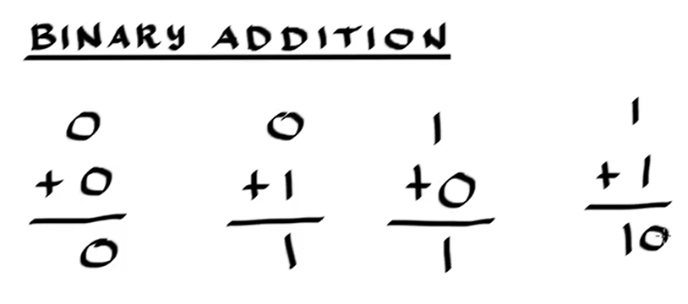

Slide 5
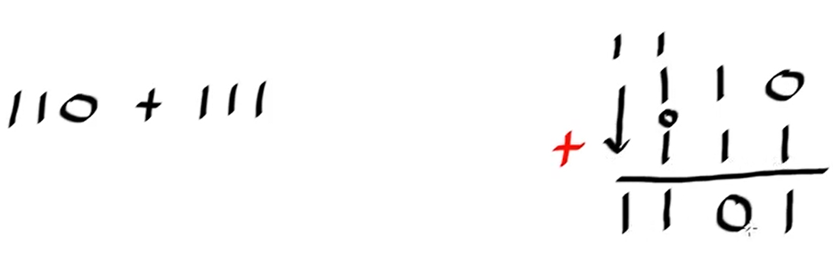
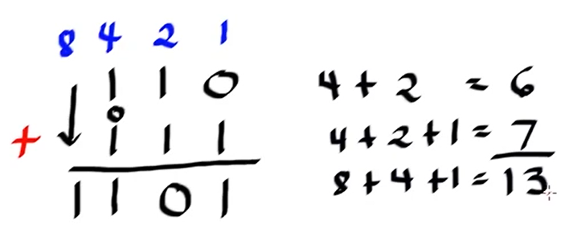

Slide 6
Add the binary numbers-
11010 + 11001=
2.10011 + 10110=
3.10001 + 11000=
4.10111 + 1100=
5.1111 + 1100=

Slide 7
Appetizer #8: Add the binary numbers-
111010 + 111001=
2.110011 + 110110=
3.100001 + 111000=
4.10011 + 1100=
5.11100 + 11000=
6. 11100 + 1100=

Slide 8
BINARY NUMBERS subtraction
ICT 9 - Computer Systems Servicing

Slide 9


Slide 10
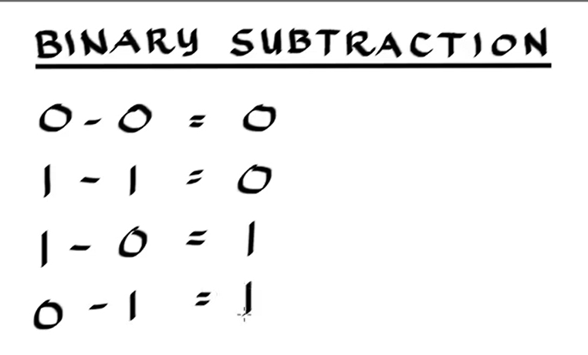

Slide 11
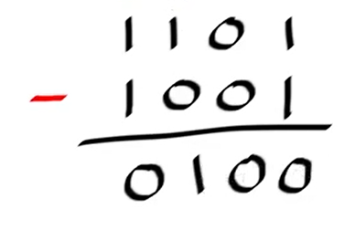
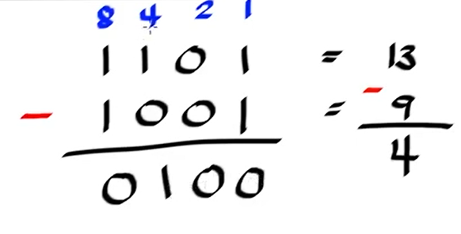

Slide 12
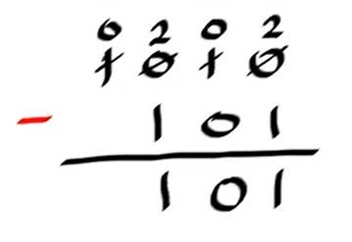
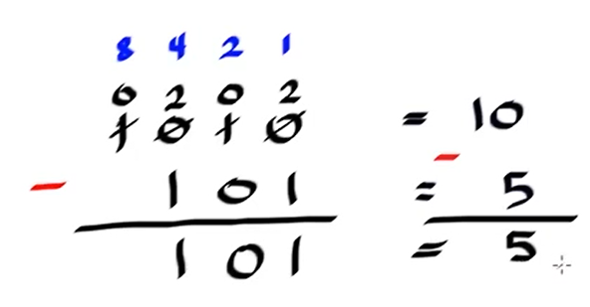

Slide 13
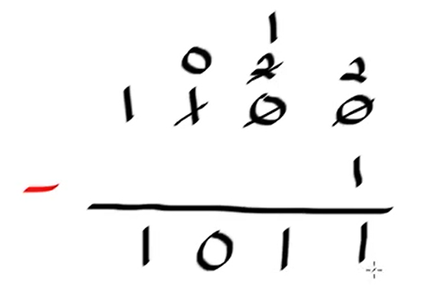
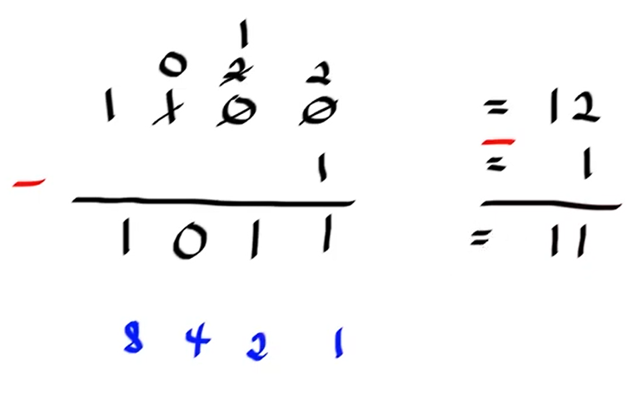

Slide 14
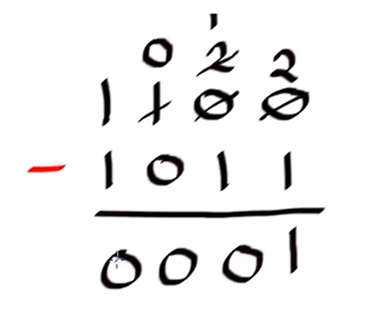
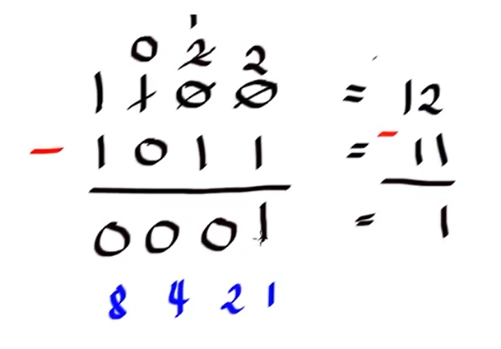

Slide 15
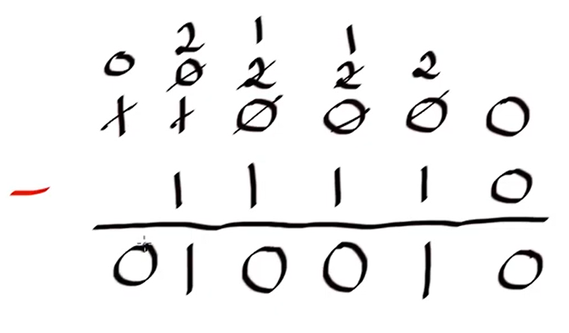
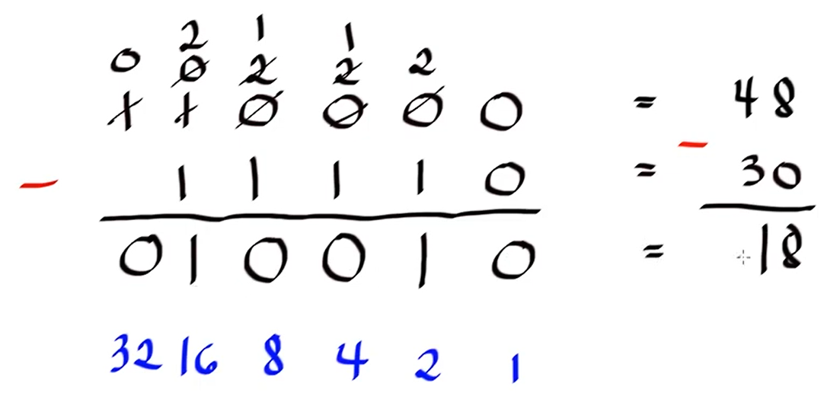

Slide 16
Appetizer #9: Subtract the binary numbers-
1111 - 1001=
2.11101 - 11011=
3.1001 - 100=
4.10011 - 1100=
5.1100 - 1001=
6. 11100 - 1100=

Slide 17
Thank You
for Learning
Teacher Mavic

Slide 18
Appetizer #10: Subtract the binary numbers-
11100 - 11001=
2.110011 - 110110=
3.100001 - 111000=
4.1001 - 1000=
5.111001 - 110100=
6. 101 - 100=
7. 1100 - 1001=

